Slide 1
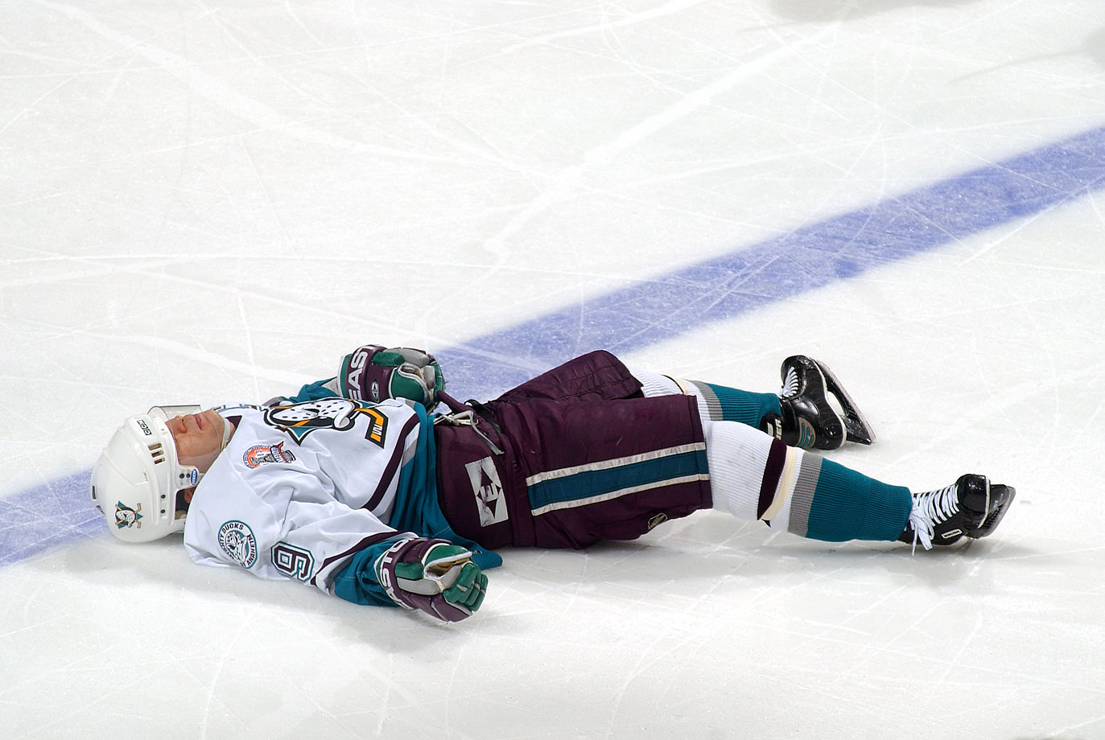
Concussions and the Physics of Helmets
Eric Neal
PHYS 420

Slide 2
What is a Concussion?
“A concussion is a type of traumatic brain injury—or TBI—caused by a bump, blow, or jolt to the head or by a hit to the body that causes the head and brain to move rapidly back and forth. This sudden movement can cause the brain to bounce around or twist in the skull, creating chemical changes in the brain and sometimes stretching and damaging brain cells.”
- cdc.gov

Slide 3
Concussion Effects
Concussions are cumulative
Once a person has had a concussion they are more susceptible to concussions in the future
Concussions can lead to long-term side effects, such as chronic traumatic encephalopathy (CTE)
CTE can cause issues such as parkinsonism, speech and memory problems, slowed mental processing, tremor, and depression.
Notes:
Movie is about a doctor who performs an autopsy on a former football player, discovers the dangers of brain injuries. Fights with the nfl about his research.
Pretty sure there is a current lawsuit by a bunch of former players against the nfl about this.

Slide 4
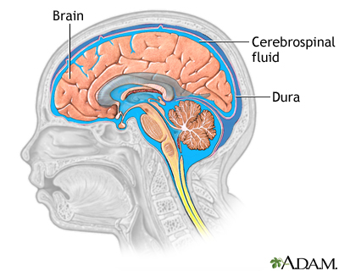
Concussion vs. Skull Fracture
Brain injury can occur from forces much less than what is needed to crack a skull
Concussions can also result from other rapid accelerations and shaking of the head, like whiplash
Notes:
Dura mater or dura, is a thick membrane that is the outermost of the three layers of the meninges that surround the brain and spinal cord

Slide 5
How much energy in a collision?
Conservation of energy:
$$PE=mgh$$
$$KE= \frac{1}{2}mv^{2}$$
$${PE}_{i}+{KE}_{i}={PE}_{f}+{KE}_{f}$$
How much kinetic energy will the head have at impact?
How much energy will be absorbed by the helmet?
Notes:
NOTE: from now on we are talking about dropping an object from a height

Slide 6
Impulse: Change in Momentum
Newton’s 2nd Law:
$$F=ma=m\frac{∆v}{∆t}$$
Impulse:
$$Impulse= F_{avg}Δt=mΔv= Δp$$
Where $F_{avg}$ is the average force during the collision and $Δt$ is the duration of the collision

Slide 7
How does a helmet reduce the force during a collision?
$$F_{avg}Δt=mΔv$$
How will each variable change if we add a helmet?
$$m$$
$$Δv$$
$$Δt$$
unchanged (if we assume the mass of the helmet is negligible)
unchanged
INCREASES – The helmet makes the collision time longer
Result: F_{avg} must DECREASE
Notes:
Time of the collision is from when it first hits until it comes to a complete stop

Slide 8
Work-Energy Principle
$$Work Done by Ground=Change in Kinetic Energy$$
$$W= ∆KE={KE}_{f}−{KE}_{i}$$
$$W=0−\frac{1}{2}m{v_{f}}^{2}$$
$$F_{avg}d= −\frac{1}{2}m{v_{f}}^{2}$$
Where $F_{avg}$ is the average force on the head during the collision, $d$ is the distance over which the collision occurs, $m$ is the mass of the head, and $v_{f}$ is the velocity of the head at impact.
Notes:
Now “initial” is immediately before the collison, “final”is immediately after

Slide 9
How does a helmet reduce the force during a collision?
$$F_{avg}d= −\frac{1}{2}m{v_{f}}^{2}$$
How will each variable change if we add a helmet?
$$m$$
$$v_{f}$$
$$d$$
unchanged (if we assume the mass of the helmet is negligible)
unchanged
INCREASES – The helmet makes the collision DISTANCE longer
Result: F_{avg} must DECREASE
Notes:
Examples: bending your knees, airbag, catching something someone threw really hard

Slide 10
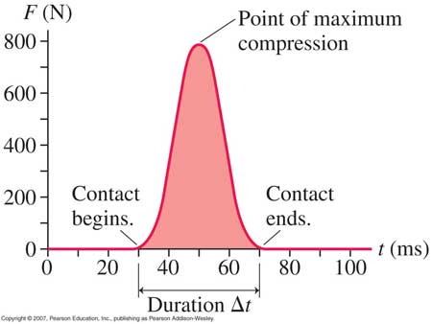
Force vs. Time Graph

Slide 11
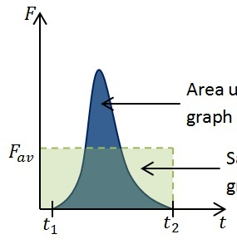
Impulse = Area under the curve
$$Impulse=\int_{t_{1}}^{t_{2}}{F dt}$$
$$Impulse= F_{avg}∆t=F_{avg}\left(t_{2}−t_{1}\right)$$

Slide 12
Worksheet break

Slide 13
A = 48 N*s
A = 48 N*s
Δt = | Δt =
F_{max} = | F_{max} =
Impulse = | Impulse =
7 seconds
10 seconds
12 N
8 N
18 N*s + 12 N*s + 18 N*s = 48 N*s
16 N*s + 16 N*s + 16 N*s = 48 N*s
Notes:
Delta t is from when the object first hits until it is completely stopped

Slide 15
Predictions
If the 10.6 kg mass is dropped from a height of 0.1 m, what will be the impulse of the collision?
How much do you think adding a helmet will change the maximum force of the collision?
$$Impulse=mΔv= Δp$$
$${PE}_{i}+{KE}_{i}={PE}_{f}+{KE}_{f}$$
$$PE=mgh$$
$$KE= \frac{1}{2}mv^{2}$$
Notes:
Measure mass of ball on force plate
Set a height we will drop from – table?
Hint: find impact velocity first
Write peak force predictions on board

Slide 16
Demo
Notes:
Explain what I’m going to do:
Logger pro
Force plate
Mass of human head is about 4 or 5 kg
Spin zone the pillow
I tried the helmet, it wasn’t giving consistent results
Pillow will exaggerate the effect and make it easier to see the difference

Slide 17
Analysis
Which trial had the largest peak force?
Which had a larger impulse?
How accurate were our predictions?
What factors could have caused the data to differ from our predictions?
Notes:
Did it bounce more with the pillow? Any bounce will increase the impulse (greater change in momentum)

Slide 18
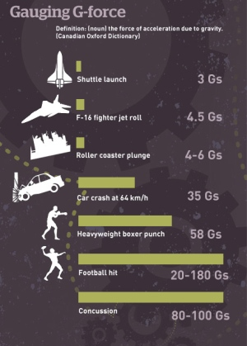
How many “Gs”?
“G-force” is actually an acceleration
Can use F = ma to find how many Gs you are accelerating with
Example:
3 Gs means you are accelerating at
3 x 9.8m/s² = 29.4 m/s²
Notes:
If time, can calculate how many G’s our collision had
a = F/m x (1G/9.8ms-1)

Slide 19
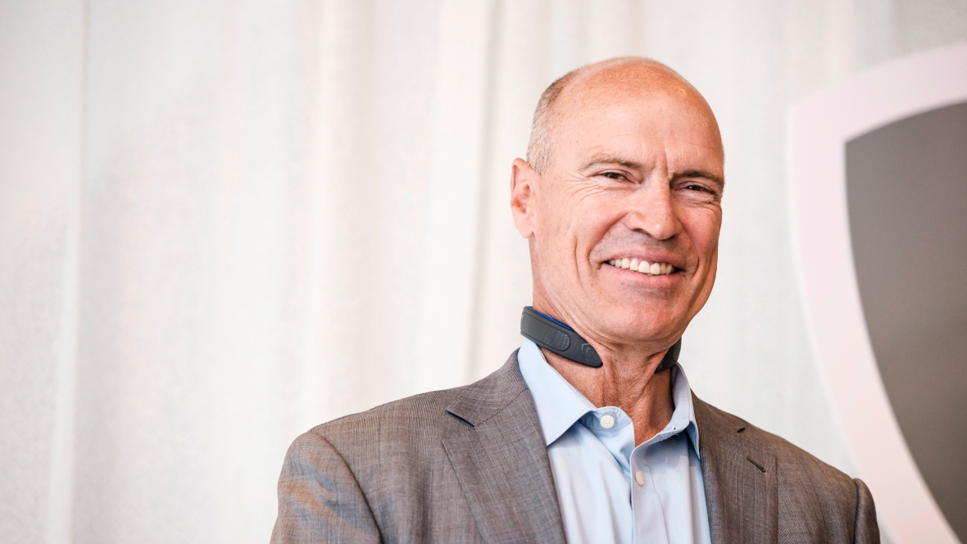
Concussion Discussion
Will helmets ever be able to prevent concussions?
Recent push for player safety in sports
https://www.youtube.com/watch?v=ikYFfxpu3I0
Notes:
My demonstration was very simplified, real helmet is much more complicated.
Hovding: Swedish, basically an airbag on your head
Bauer Neuroshield: recently came out, is worn around the neck and applies a slight pressure that increases blood volume in the veins around the brain,helping to reduce movement of the brain inside the skull. Seems kinda sketchy to me

Slide 20
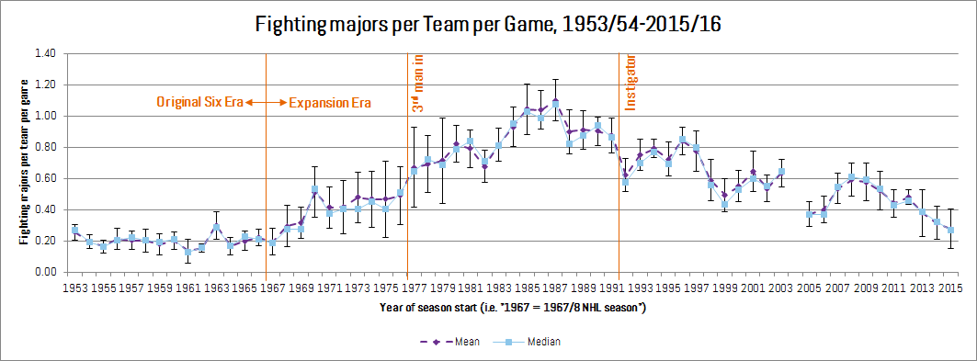
https://www.youtube.com/watch?v=__H6Gvdn8WY
https://www.youtube.com/watch?v=McStQJiOPeY

Slide 21
The End

